Slide 1

Project Presentation on Full Stack Engineering (FSE)
On
EasyMart
Submitted by:
Jasjeet Kaur (2210990442)
Kanchan Yadav (2210990471)
Supervised By:
Mr. Gautam Mukherjee
Department of Computer Science and Engineering,
Chitkara University, Punjab

Slide 2
Table of Contents
Introduction
Software Requirement
Hardware Requirement
Feasibility Study
Techniques Used
Results
Conclusion
References/Links used
Q&A

Slide 3
Introduction
Our project idea is to provide a seamless and user-friendly platform for vendors and customers to engage in online shopping. It aims to simplify the e-commerce experience by allowing vendors to list products, manage inventory, and interact with customers, while enabling customers to browse, purchase products, and receive notifications about their orders. The platform strives to create an efficient and secure environment for both parties to conduct business smoothly.

Slide 4
Software Requirements
Frontend: React.js
Backend: Node.js with Express.js
Database: MySQL
Authentication: JWT (JSON Web Tokens)
Email Service: NodeMailer
Version Control: Git & GitHub

Slide 5
Hardware Requirements
Development Machine:
Processor: Intel i5 or higher
RAM: 8 GB minimum
Storage: SSD with at least 256 GB free space
Server:
CPU: Multi-core processor
RAM: 16 GB or more
Storage: SSD with sufficient capacity
Network: Stable internet connection

Slide 6
Feasibility Study
Technical Feasibility: Utilizes well-established technologies like React, Node.js + Express.js , and MySQL, ensuring robust performance.
Operational Feasibility: User-friendly interfaces for both vendors and customers, promoting ease of use.
Economic Feasibility: Open-source tools minimize costs, making the project economically viable.

Slide 7
Techniques Used
Authentication: JWT for secure user sessions.
Email Notifications: NodeMailer for sending emails upon registration and other events.
Database Management: MySQL for structured data storage.
Role-Based Access Control: Differentiated dashboards and functionalities for vendors and customers.
Version Control: Git for tracking changes and collaboration.

Slide 8
Key Features
User Registration & Login: Secure authentication with role-based access for vendors and customers.
Product Management: Vendors can list and manage their products effortlessly.
Email Notifications: Automated email notifications for account creation, order updates, and more.
Secure Authentication: JWT-based authentication ensures secure user sessions.
Responsive UI: Easy-to-use interface with seamless navigation for both vendors and customers.

Slide 9
Key Features
Vendor / Customer Profile: Vendors can manage their personal information, store details, and settings.
Vendor / Customer Dashboard: Vendors have access to a dedicated dashboard to view orders, products, and sales analytics.
Wishlist: Customers can add products to their wishlist for future purchases.
Cart: Customers can add products to their shopping cart and proceed to checkout.

Slide 10
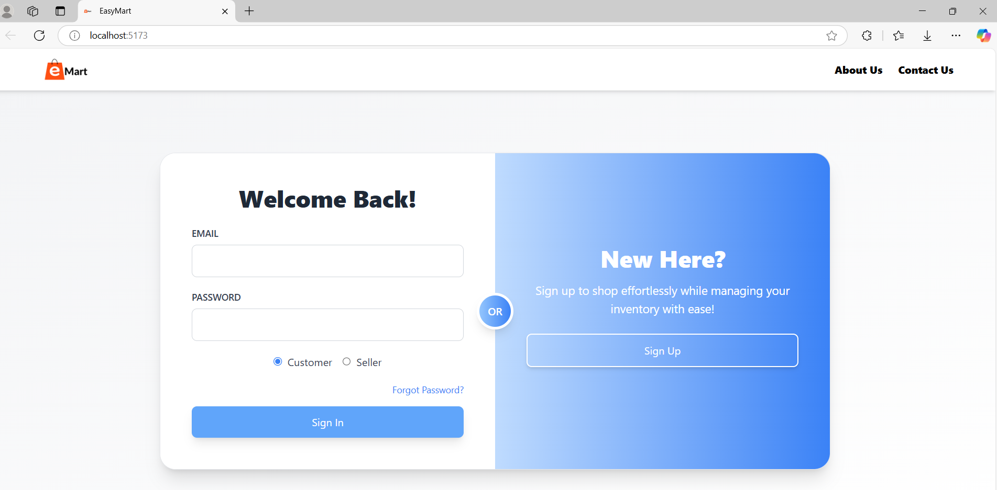
Project Highlights

Slide 11
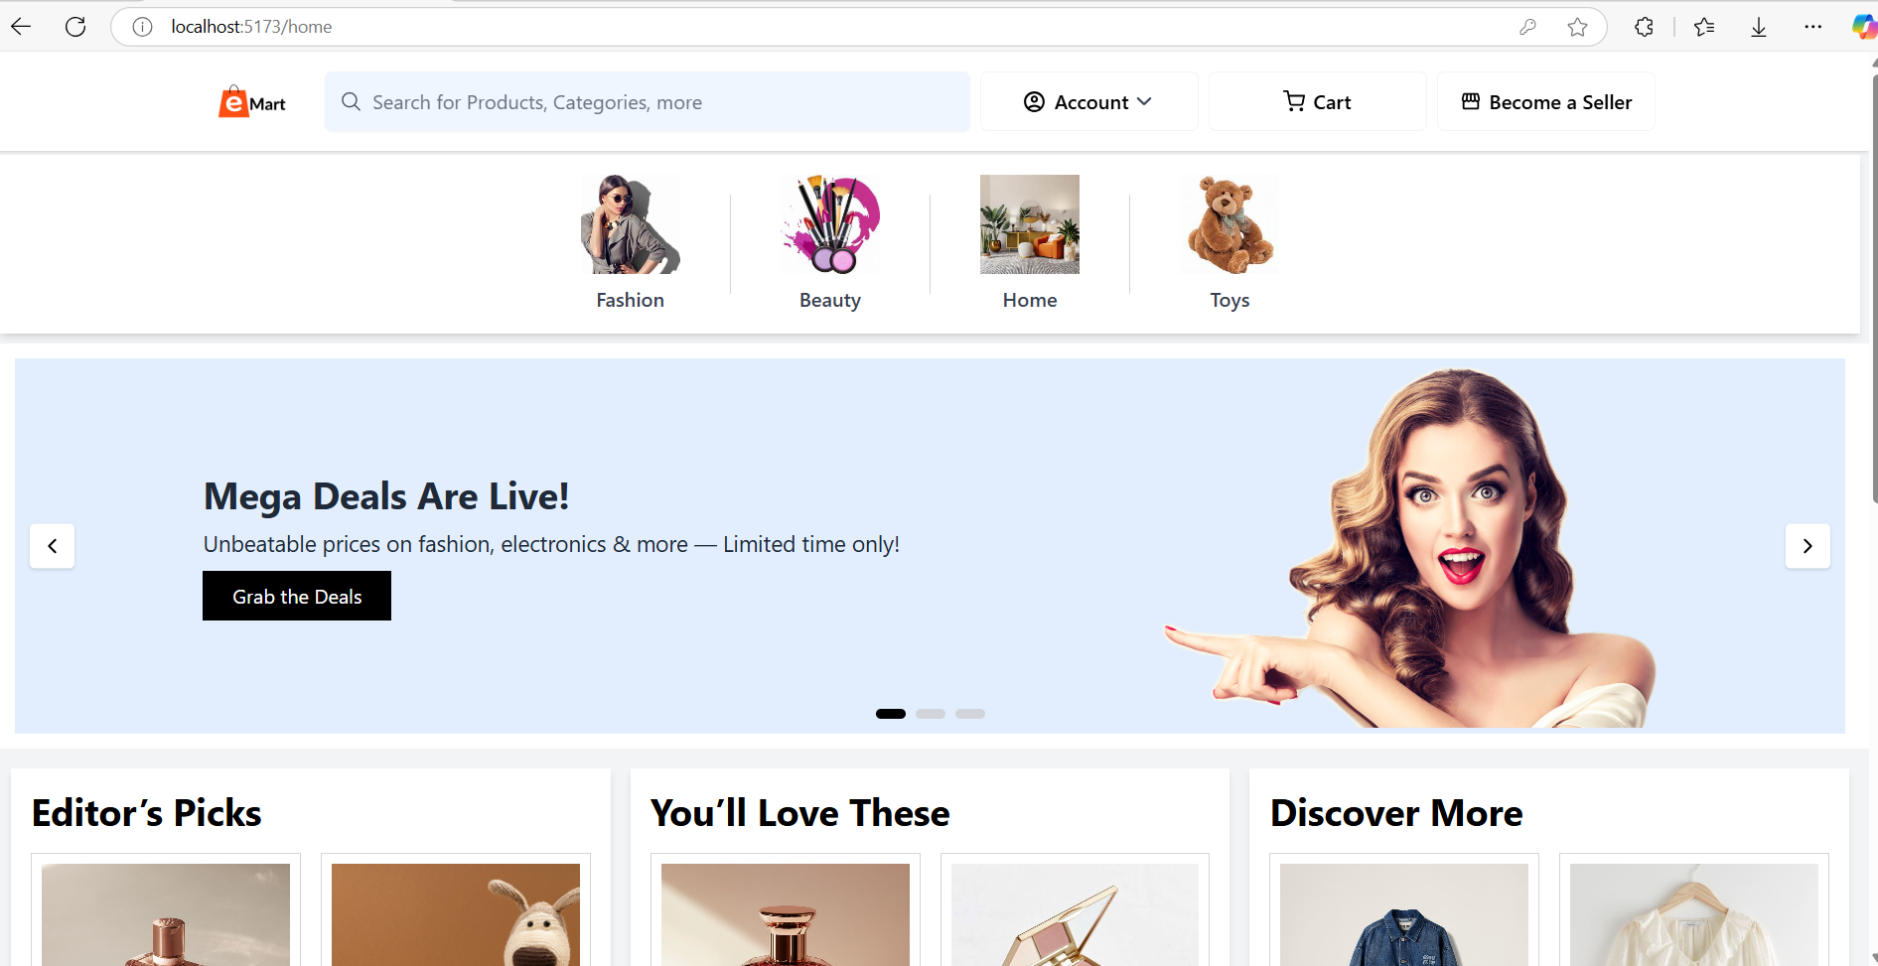
Project Highlights

Slide 12
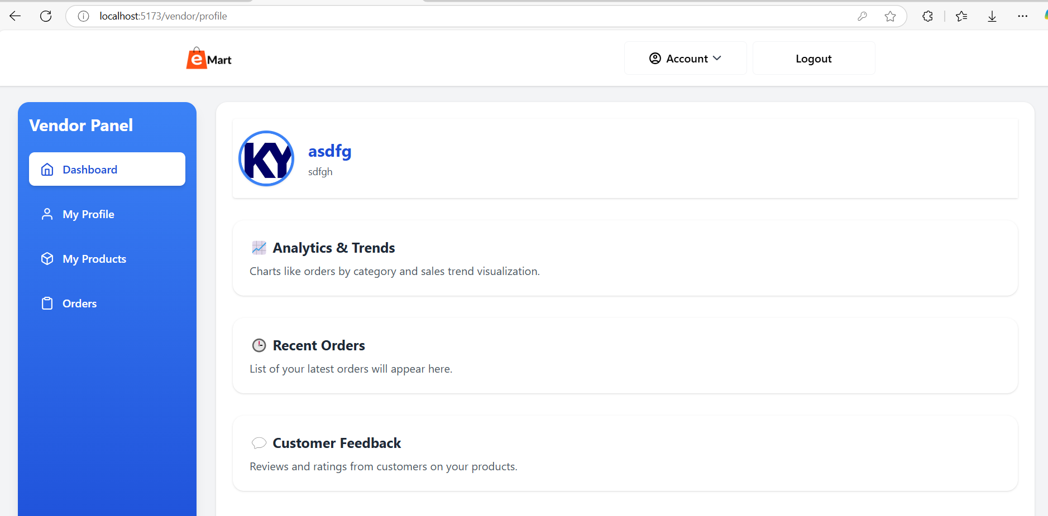
Project Highlights

Slide 13
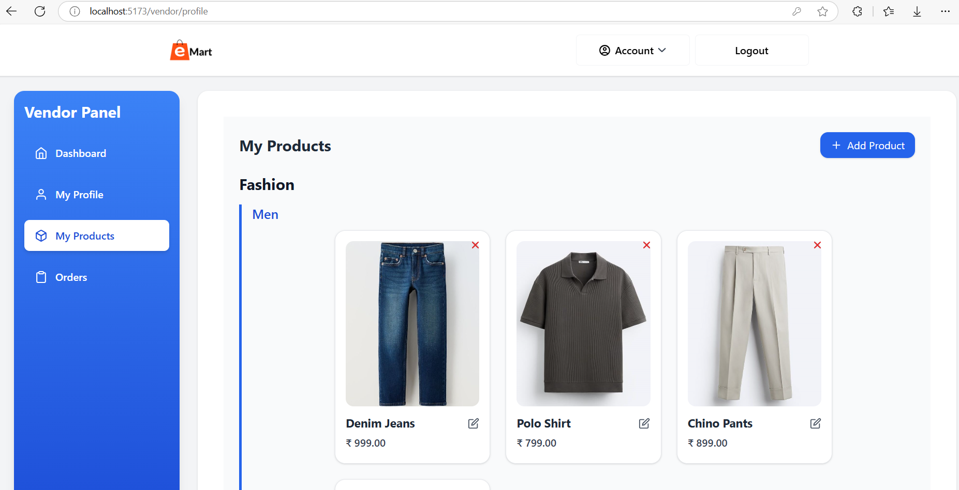
Project Highlights

Slide 14
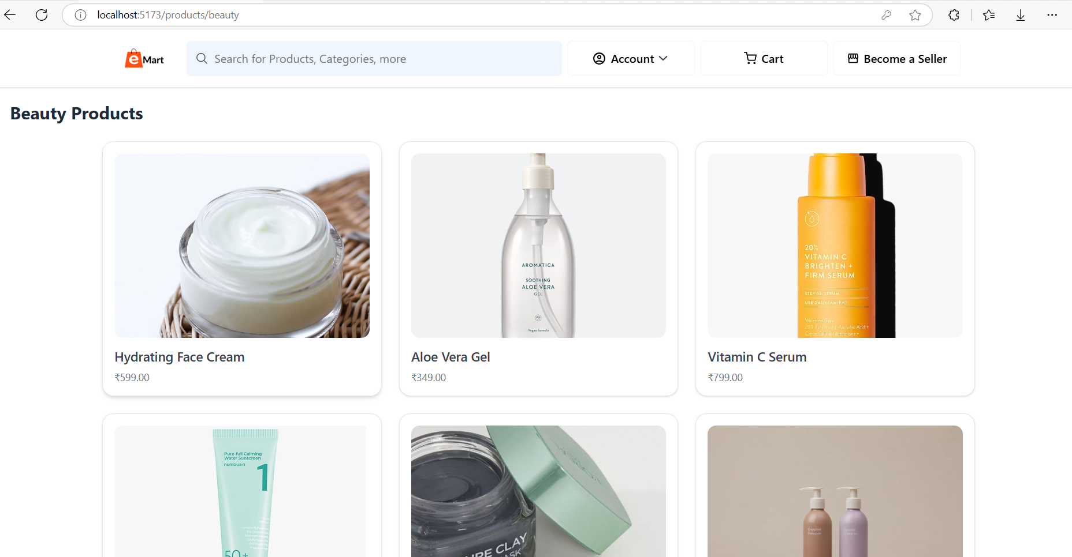
Project Highlights

Slide 15
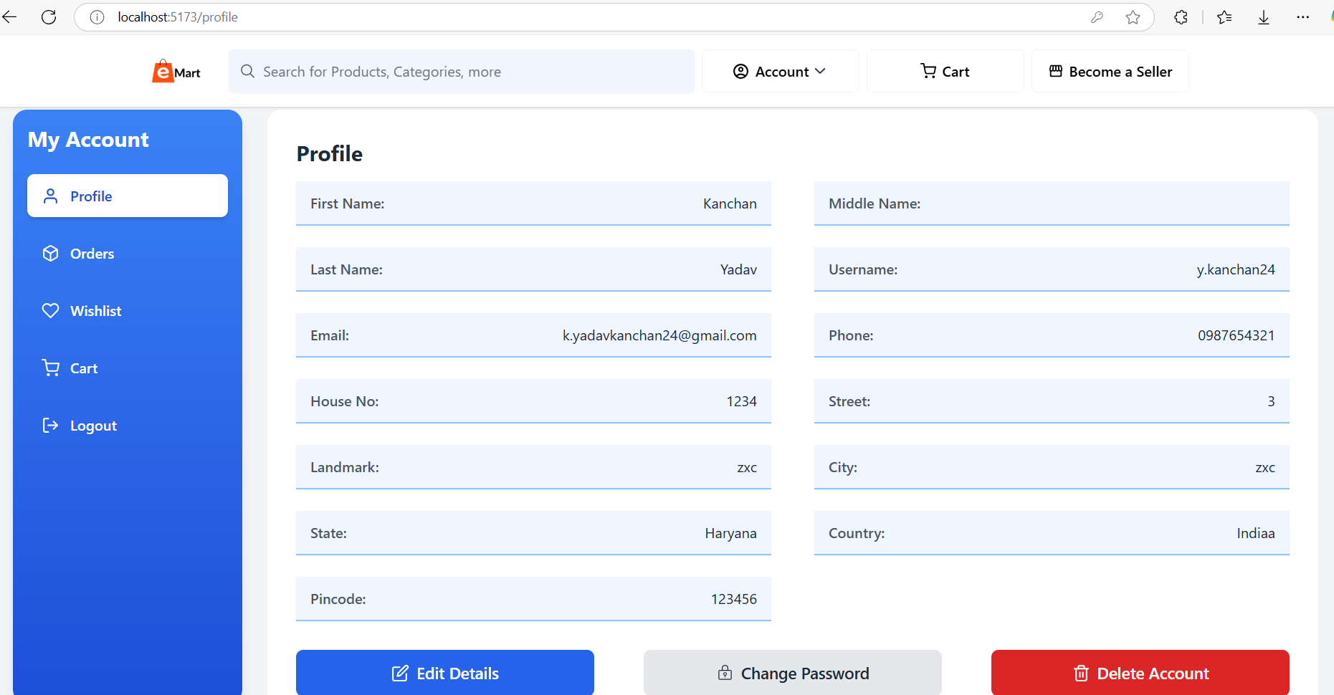
Project Highlights

Slide 16
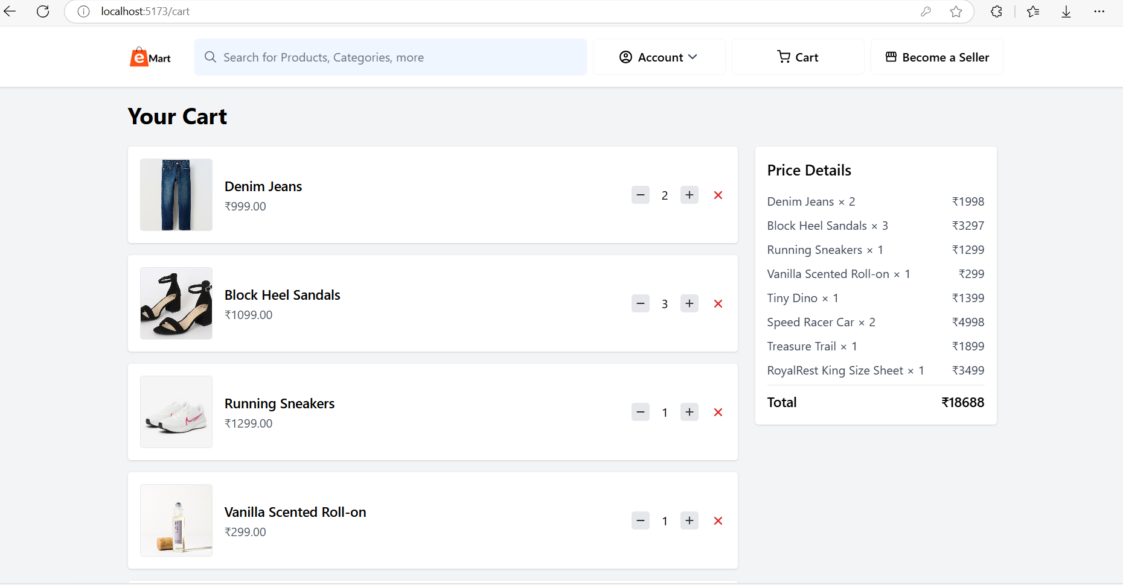
Project Highlights

Slide 17
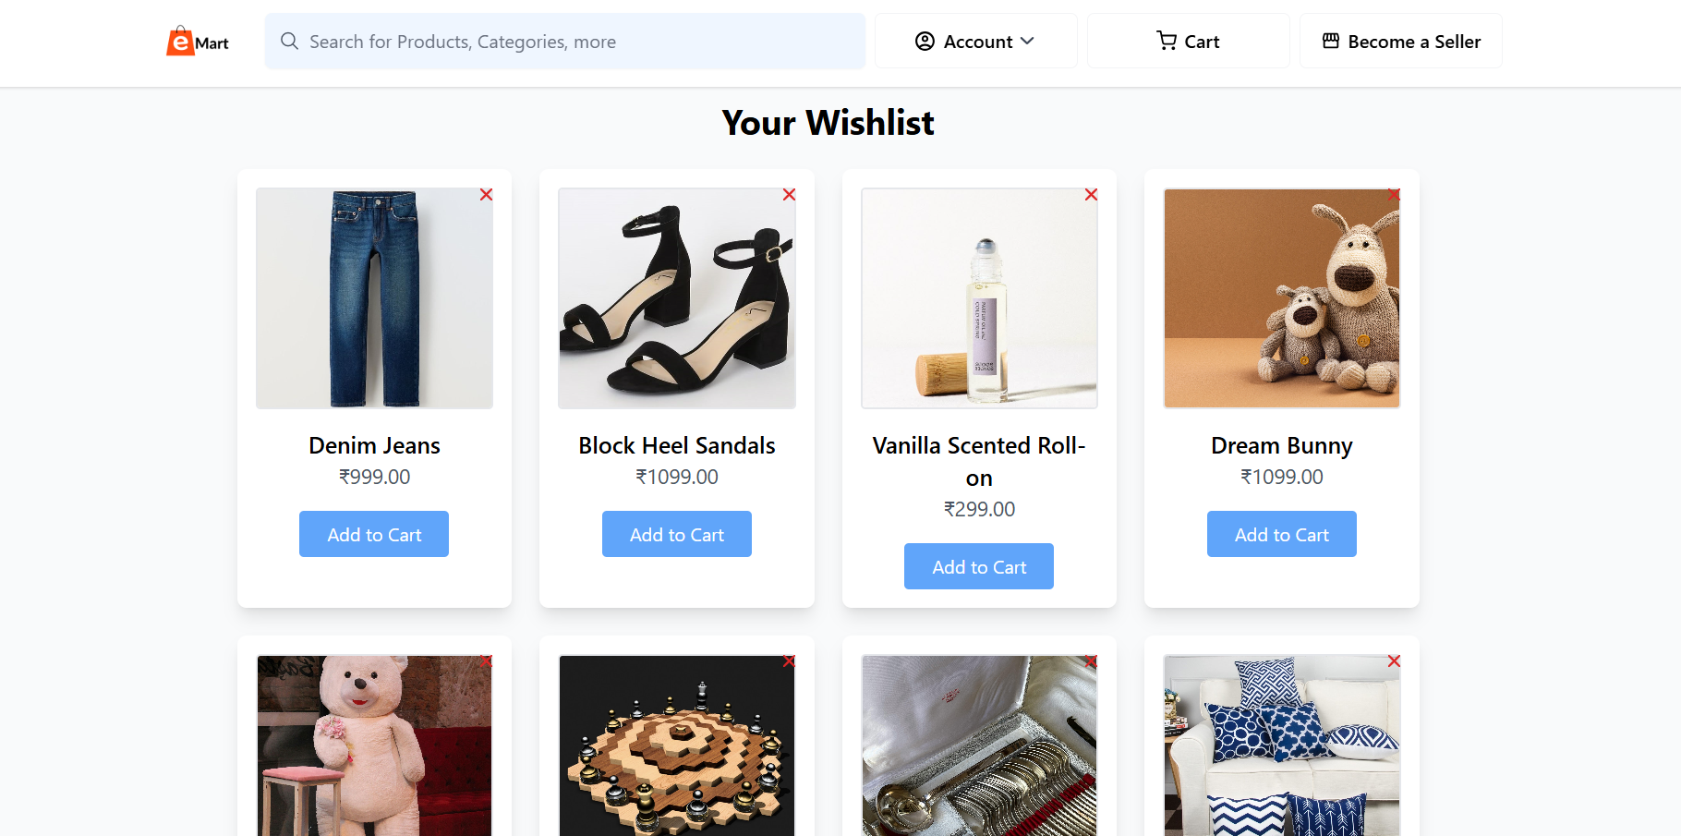
Project Highlights

Slide 18
Results
Implemented Features:
User registration and login with role differentiation.
Secure authentication mechanisms.
Email notifications for user interactions.
Structured data management with MySQL.
User Experience: Intuitive interfaces tailored for both vendors and customers.

Slide 19
Conclusion
EasyMart successfully integrates essential e-commerce functionalities, providing a seamless platform for vendors and customers.
The use of modern technologies ensures scalability and maintainability.
Future enhancements can include payment gateway integration, product reviews, and advanced analytics.

Slide 20
Repository Link
https://github.com/ydv-kanchan/EasyMart/tree/main
Contributing We welcome contributions from everyone! If you're interested in contributing:
Fork the repo
Create a new branch
Commit your changes
Push and create a pull request

Slide 21
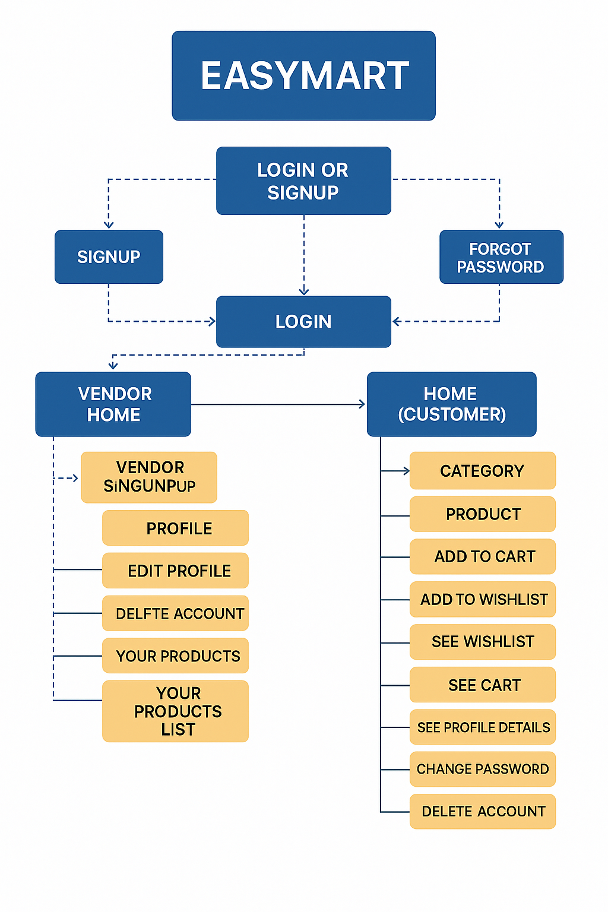
Architecture

Slide 22


Slide 23


